Slide 1
Disaster Management

Slide 2
Index
What Is A Disaster
Floods
Tsunami
Landslides
Volcano Eruptions
Cyclone
Earthquake
What The Government Should do
What We Should DO
Planning In Disaster Prone Areas

Slide 3
ACKNOWLEDGEMENTS
This project that I have made about disaster management was encouraged by my
teachers and my parents. During the making of this project I have learnt what all
difficulties that prole have faced. I have learnt that nature is unpredictable and
tampering with it has severe consequences. I thank my teachers and my parents
because they have truly helped me to understand and remember tough concepts
quite easily.

Slide 4
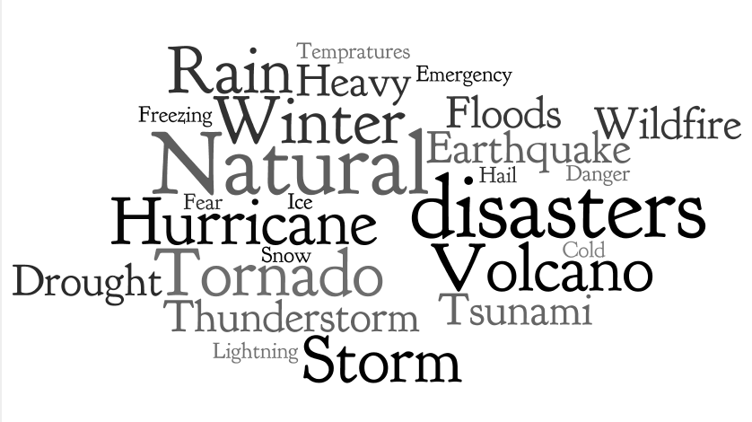
WHAT IS A DISASTER
A disaster is a sudden, calamitous event that seriously disrupts the functioning of a community or society and causes human, material, and economic or environmental losses that exceed the community’s or society’s ability to cope using its own resources. Though often caused by nature, disasters can have human origins.
The combination of hazards, vulnerability and inability to reduce the potential negative consequences of risk results in disaster.

Slide 5
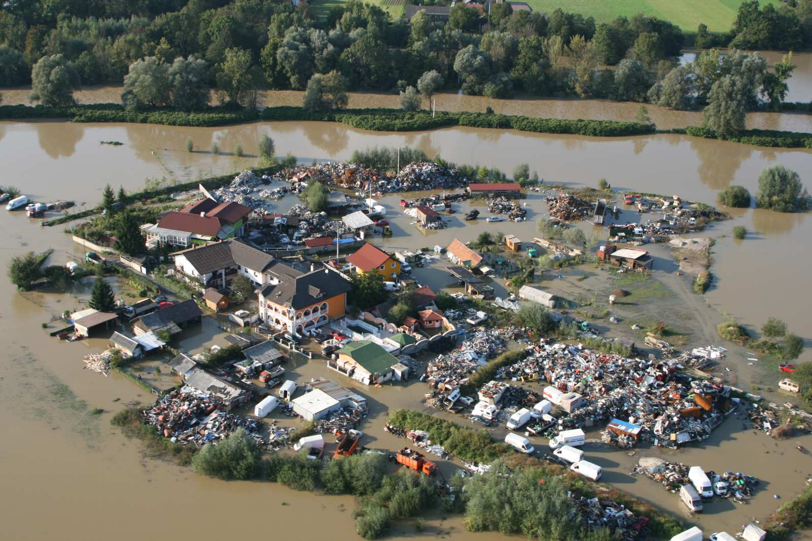
FLOODS
A flood is an overflow of water that submerges land which is usually dry. The EU, Floods Directive defines a flood as a covering by water of land not normally covered by water. In the sense of "flowing water", the word may also be applied to the inflow of the tide.
Flooding occurs most commonly from heavy rainfall when natural watercourses do not have the capacity to convey excess water. However, floods are not always caused by heavy rainfall. They can result from other phenomena, particularly in coastal areas where inundation can be caused by a storm surge associated with a tropical cyclone, a tsunami or a high tide coinciding with higher than normal river levels. Dam failure, triggered for example by an earthquake, will result in flooding of the downstream area, even in dry weather conditions.
Here's what you can do to stay safe during a flood: If flooding occurs, go to higher ground and avoid areas subject to flooding. Do not attempt to walk across flowing streams or drive through flooded roadways. If water rises in your home before you evacuate, go to the top floor, attic, or roof.

Slide 6
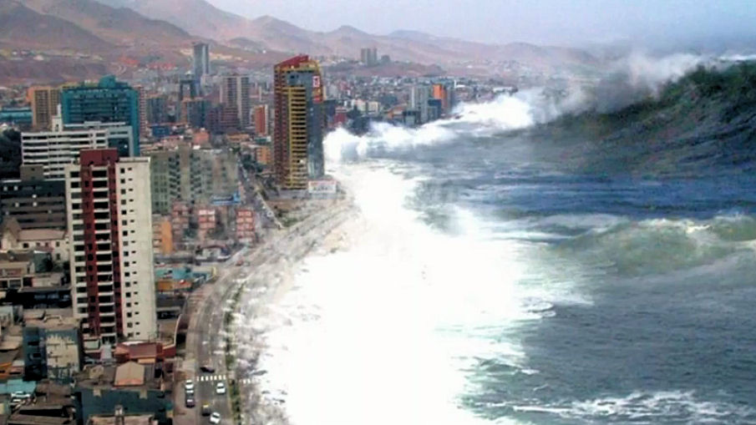
TSUNAMI
Tsunami. The phenomenon is usually associated with earthquakes, landslides in, or adjacent to oceans, and results in sudden movement of the water column.
A tsunami is different from a wind generated surface wave on the ocean. The passage of a tsunami involves the movement of water from the surface to the seafloor which means its speed is controlled by water depth. Consequently, as the wave approaches land and reaches increasingly shallow water it slows. However, the water column still in deeper water is moving slightly faster and catches up, resulting in the wave bunching up and becoming much higher. A tsunami is often a series of waves and the first may not necessarily be the largest.
The first thing you should try to do, if possible, is to move away from the coast, lagoons or other bodies of water, towards higher ground and even into hills or mountains. Move until you are either 2 miles (3,200 m) inland or 100 feet (30 m) above sea level.

Slide 7
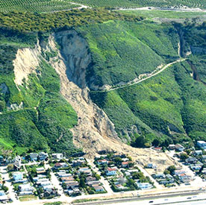
LANDSLIDES
A landslide is the movement of rock, debris or earth down a slope. They result from the failure of the materials which make up the hill slope and are driven by the force of gravity. Landslides are known also as landslips, slumps or slope failure.
Natural causes include:
elevation of pore water pressure by saturation of slope material from either intense or prolonged rainfall and seepage
vibrations caused by earthquakes
undercutting of cliffs and banks by waves or river erosion
volcanic eruptions.
Human causes include:
removal of vegetation
interference with, or changes to, natural drainage
leaking pipes such as water and sewer reticulation
modification of slopes by construction of roads, railways, buildings, etc.
overloading slopes
mining and quarrying activities
vibrations from heavy traffic, blasting, etc.
excavation or displacement of rocks.

Slide 8
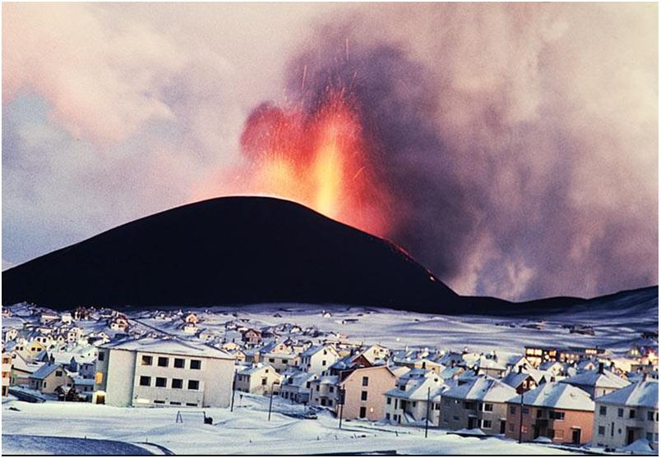
VOLCANO ERUPTIONS
A volcano is a vent or chimney which transfers molten rock known as magma from depth to the Earth's surface. Magma erupting from a volcano is called lava and is the material which builds up the cone surrounding the vent.
A volcano is active if it is erupting lava, releasing gas or generates seismic activity. A volcano is dormant if it has not erupted for a long time but could erupt again in the future. Once a volcano has been dormant for more than 10 000 years, it is termed extinct
Where plates move away from each other at spreading or divergent plate margins, volcanic eruptions are gentle extrusions of basaltic lava. Most of these occur underwater where magma rises from great depth below to fill the space created by seafloor spreading which occurs at a rate of about 10 centimetres a year.

Slide 9
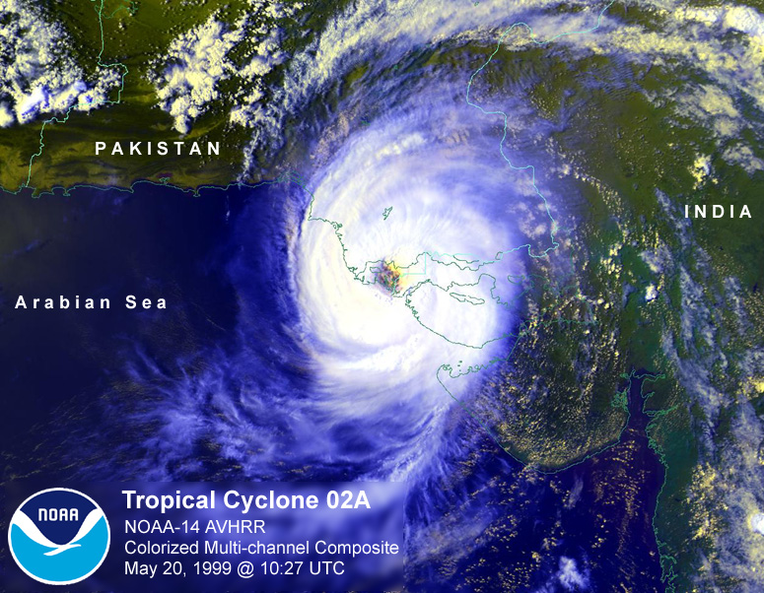
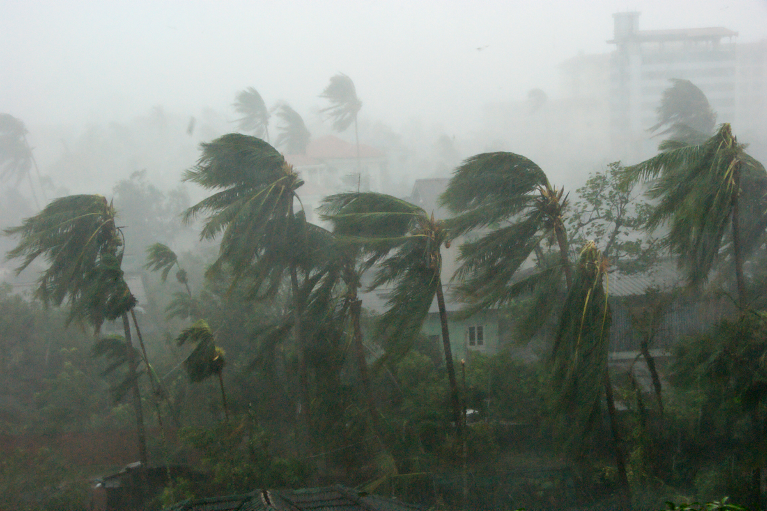
CYCLONES
A tropical cyclone is a low-pressure system which develops in the tropics and is sufficiently intense to produce sustained gale force winds of at least 63km/h. If the sustained wind reaches hurricane force of at least 118km/h the system is defined as a severe tropical cyclone. In other parts of the world they are called hurricanes or typhoons.
Tropical cyclones can cause significant phenomena which can adversely, and sometimes favorably impact on communities and the environment. The most common features are destructive winds and heavy rainfall that can lead to flooding. Storm surge, or coastal inundation by seawater, is a lesser known phenomenon but can be the most dangerous element of a cyclone. Though rare in Australia, tornadoes have been reported during cyclone events.

Slide 10
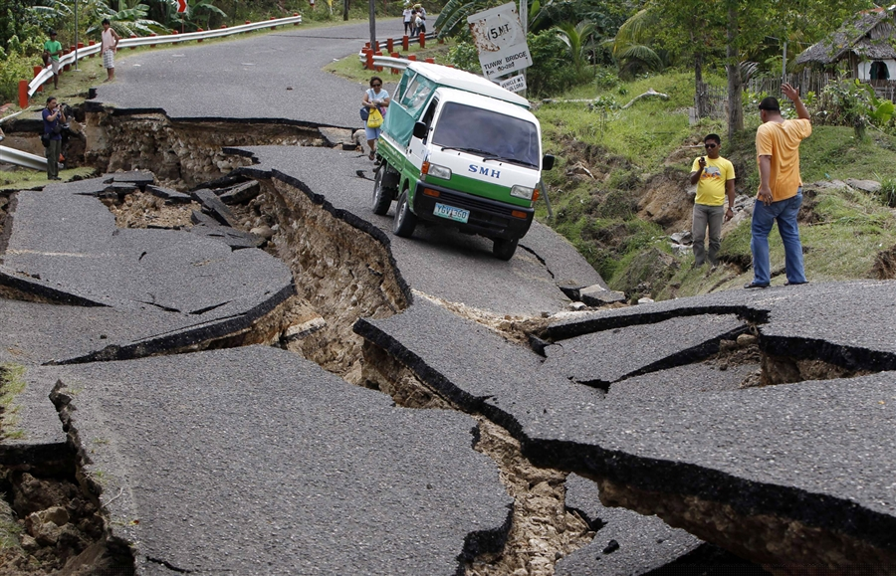
Earthquakes
Earthquakes are the vibrations caused by rocks breaking under stress. The underground surface along which the rock breaks and moves is called a fault plane.
The size or magnitude of earthquakes is determined by measuring the amplitude of the seismic waves recorded on a seismograph and the distance of the seismograph from the earthquake. These are put into a formula which converts them to a magnitude, which is a measure of the energy released by the earthquake. For every unit increase in magnitude, there is roughly a thirty-fold increase in the energy released. For instance, a magnitude 6.0 earthquake releases approximately 30 times more energy than a magnitude 5.0 earthquake, while a magnitude 7.0 earthquake releases approximately 900 times (30x30) more energy than a magnitude 5.0.

Slide 11
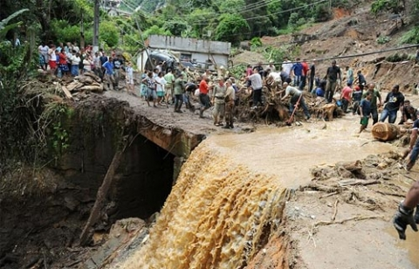
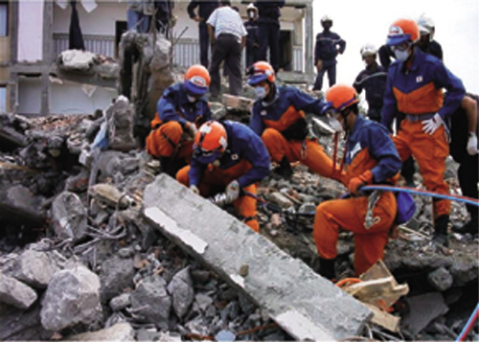
What Government Should Do
In the immediate aftermath of a disaster, federal assistance is made available only after a formal request has been made by a state’s governor. The extent or the impact of a natural or man-made event can qualify a region of a state to be declared a disaster. The President makes this declaration, and once made, it initiates the efforts of the Federal Emergency Management Agency, known as FEMA. FEMA reacts as quickly as possible to the devastation caused by a disaster to provide immediate aid and relief to those affected; this is known as the disaster response phase. After the disaster is over and it is time to rebuild, the recovery phase begins, and with it come additional sources of aid.

Slide 12
What We Can Do
Staying aware of the signs around us.
Irregular behaviour of animals.
Slight tremors.
Reading on the Richter scale.
Being aware of what to do during whichever circumstances.
During a disaster, while you are in a house . Just take some blankets and some eating items for your family so that you’ll all can survive . Leave all the other belongings back, Because the more you carry with you the difficult it is to escape.
Duking down things while a earthquake takes place

Slide 13
Planning In Disaster Prone Areas
It has been recognized that the available scientific knowledge is not being fully utilized in forecasting the hazards, estimating the risks, and getting the necessary outreach for the benefit of the public, particularly in a large part of the area covered by Asia and the Pacific. It is important to stress:
1. disaster risk reduction and management;
2. the role of social sciences in understanding hazards and their mitigation;
3. the role of the private sector and civil societies;
4. building and enhancing regional capacity for disaster reduction;
5. building self-sustaining capacity at various levels for different hazards;
6. establishing continuity in capacity building.

Slide 14
Conclusion
This document is the outcome of intense research among the different sites made by experts who clearly explain the effects of disasters and what Planning should be done. In the foregoing, we have succeeded in identifying key problems related to earthquakes, floods and landslides etc. in regions that need to be addressed. Efforts would be made to develop suitable projects involving the concerned nations, existing national and international programmes, and experts to address the relevant issues and to find the necessary financial, physical and intellectual support. A suitable overview and review mechanism shall also be put in place.
We sincerely hope that through an appropriate development and implementation of projects, we would have many more success stories for the ROAP region and several hazard events would be prevented from becoming disasters.

Slide 15
BIBLIOGRAPHY
Google
Wikipedia.org
wikiHOW.com
Geoscience Australia
Red Cross
ICSU.org

Slide 16
GLOSSARY
EU-European Union

